Slide 1
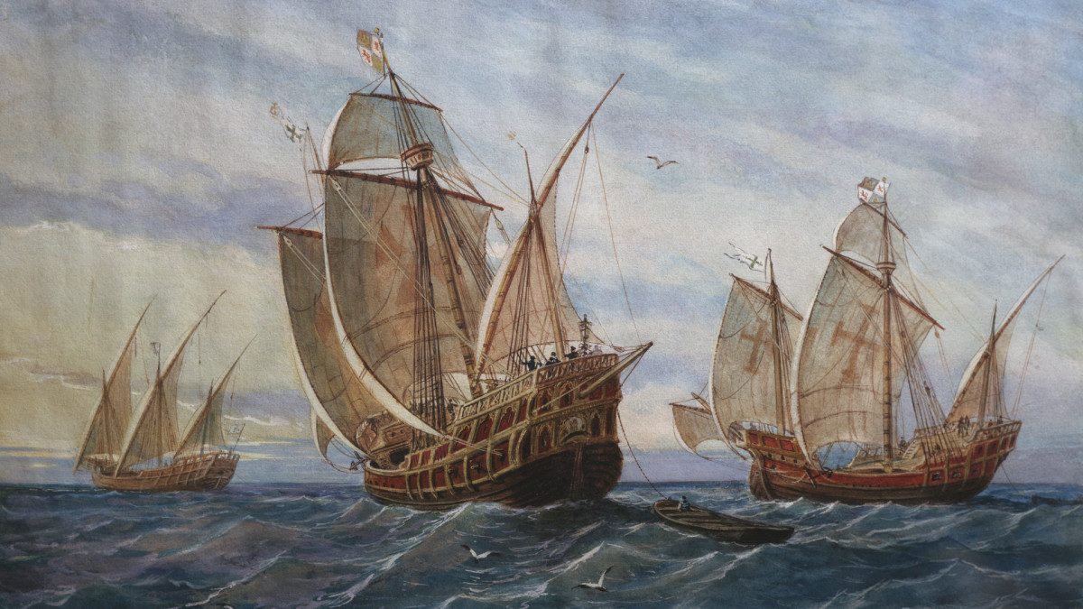
Columbus Case
Group 4: Jonathan Chang, Justin Chin, Sakura Kishiro, Haiau Vo

Slide 2

Agenda
Goals and Constraints
Assumptions
Project Plan and Schedule
Contract and Payments
Risk Management Plan
Estimated Project Cost and Duration

Slide 3
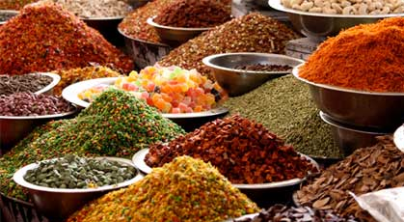
Goals
To bring back gold, spices, and other luxury goods to increase Spain’s wealth

Slide 4
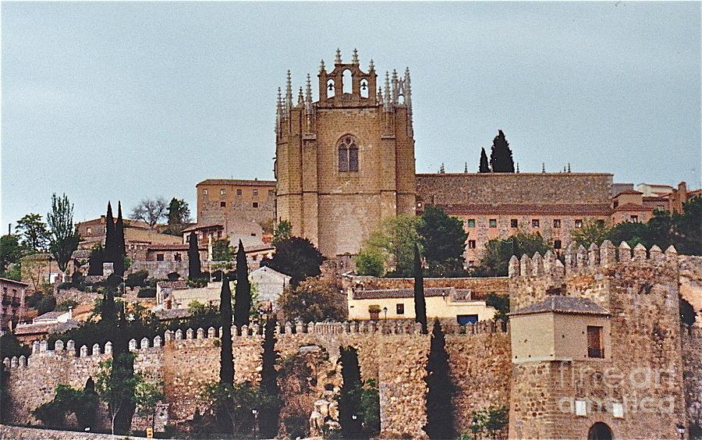
Goals
To gain a first mover advantage on other European competitors and expand Spain’s empire and wealth by securing a cheaper trade route to asia

Slide 5

Goals
To spread Christianity by evangelizing non-Christians who are encountered on the voyage

Slide 6

Constraints
minimum wage laws mean that employees must be paid a certain amount
Must purchase 3 boats
Selected boats must have a two way Probability of success of 80% or greater
Project can only start once initial royal funding is secured
Hiring ads must be advertised for at least two weeks
There are only 6 qualified boats for sale
Each boat only has the cargo capacity and crew member capacity indicated on the chart
food allotment ranges from 0.05kg to 0.08 kg per crewmember per day
The three boats must sail close together to ensure effective communication
Spain is in a recession and is concerned about costs

Slide 7
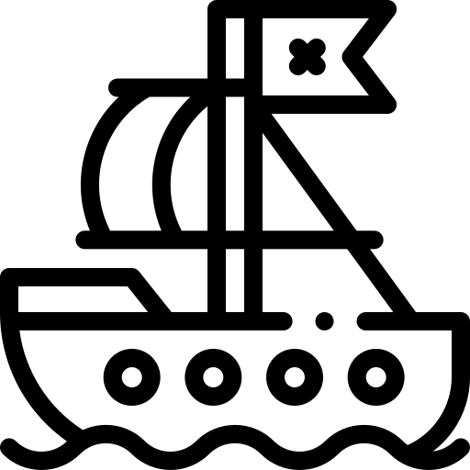
Assumptions
Prevoyage:
There are 30 days in a month
We pay captains, navigators, and crewmembers as soon as they’re hired
The crew size for each boat only accounts for the crewmembers
Will buy a mix of barebones and hole foods items (half and half split buy crew number)
Must purchase 3 different ships
In the initial 2 week job ads, the positions for captain, navigator, and crewmember are all advertised -- three ads are bought for positions on the three ships
The hiring process for navigators and crewmembers takes 2 weeks

Slide 8
Assumptions
Shakedown Cruise:
If a Shakedown cruise fails, it is assumed that only 1 boat failed (sunken or lost)
During a failure, the other 2 boats return, so they do not fail
They can only fail Shakedown twice before they terminate the project
If a boat fails, we repurchase the same boat
If the Shakedown fails, it means that the captains/navigators/crewmembers were not fit for the voyage or died, so we rehire them
Each ship is equally likely to be lost during a failure -- so we can take an average to calculate expected cost
We assume that insurance covers the repurchase cost of the failed boat
If a shakedown fails, the duration of the tasks leading up to the shakedown stay the same length of time
The expected duration of the shakedown cruise is 2.5 weeks (avg of 2 and 3 weeks)

Slide 9
Assumptions
Post-shakedown cruise:
The duration of the repairs are on a beta distribution
The duration of the final voyage is normally distributed
The ships must sail close to each other
Life insurance will for captains will only be bought upon successfully completing shakedown cruise
General assumptions:
Columbus and co. discount cash flows on a yearly basis -- because the project is not expected to take more than a year, there is no discounting
Additional cargo space (not taken up by food) can be used to store goods for trading and/or spoils acquired once in asia
Eating better food (hole foods) increases crew morale

Slide 10
PRECEDENCE NETWORK
Hire Crew
Members
Supplies Stowed
Advertise
Life Insurance
Funding Secured
Dock back in Spain
Hire Captains
Hire Navigators
Shakedown Cruise
Voyage to Asia
Voyage back to Spain
Repairs, Changes, Restock
Purchase Boats
Make Sails
Boat Insurance

Slide 11
CRITICAL PATH
Hire Crew
Members
Supplies Stowed
Advertise
Life Insurance
Funding Secured
Dock back in Spain
Hire Captains
Hire Navigators
Shakedown Cruise
Voyage to Asia
Voyage back to Spain
Repairs, Changes, Restock
Purchase Boats
Make Sails
Boat Insurance

Slide 12
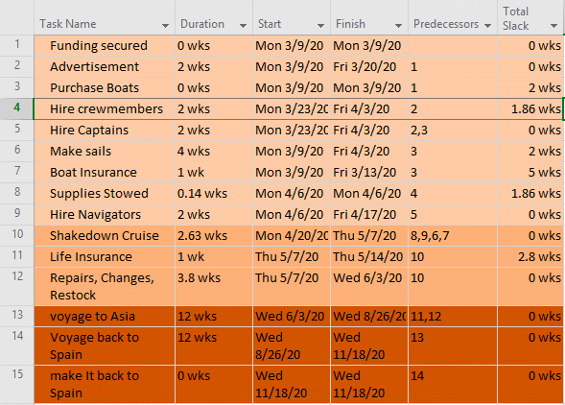
GANTT CHART

Slide 13
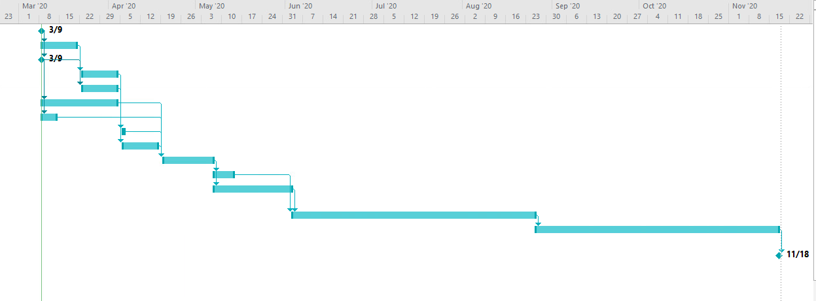
GANTT CHART

Slide 14
Work Breakdown Structure
New Trade Route to Asia
Get boats ready for voyage
Purchase 3 boats
Make sails
Stowed away supplies
Boat Insurance
Purchase Needs
Purchase food
Purchase non-edible supplies
Purchase navigation supplies
Hire staff
Place 3 ads
Hire captains
Hire Navigators
Hire crew members
Life Insurance for captains
Conduct & Adjust for Shakedown
Repair ship
Adjust staff as needed
Restock on supplies
Voyage on New Routes
Sail to Asia
Bring back spices
Spread Christianity
Sail back to Spain

Slide 15
Agile Project Management?
Some key features of Agile
Project Duration | Most likely longer with Agile
Flexibility | Will allow Columbus to make more changes in scope and features
Team size | Small, usually 5-9 people
Team make-up | Members are cross-functional and knowledgeable about all phases of the project. Brief daily meetings with all parties involved.

Slide 16
Agile Project Management?
For this specific project, we will not use Microsoft Agile because:
It could make the duration of the project and voyage longer
It is not difficult to define the tasks, costs, and durations of the project, as many of the estimates have already been made
Teams are not small, as there are more than 5-9 people on one ship
Team members do not necessarily have to be cross-functional or knowledgeable about all phases of the project. For example, a crewmember does not need to know how to perform the duties of the captain
We cannot conduct brief daily meetings, especially during the voyage because some people (like the comptroller and the King and Queen) are not coming on the voyage. Lack of technology means that these stand-up meetings cannot occur
However, if Agile had been used:
Each short task, like ‘advertising job postings’ could have been broken into an individual sprint
Could have allowed features and scope to be changed easily within sprints

Slide 17



Proposed Contract (*estimated costs and durations are calculated in later slides)
Incomplete contract because it does not specify every single consequence of every single possible state of the voyage
Partly a fixed price contract where the client pays the contractor a sum based on the estimated durations and costs of the project
Also incorporates incentives into the contract which rewards Columbus for finishing before the 275 estimated days and penalizes him for finishing after 275 days

Slide 18
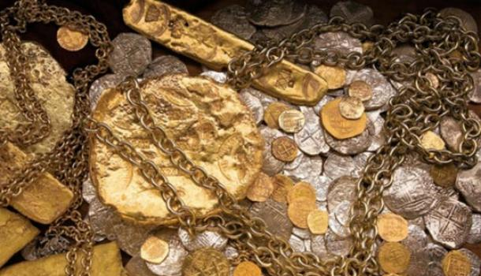
Payment Schedule (*estimated costs and durations are calculated in later slides)
One lump sum payment at the beginning of the project of $686,758. This covers all expected costs to be incurred until the Shakedown Cruise ends, including costs from the prevoyage. Costs include fixed costs like advertising as well as salaries to employees that are based off of their daily rate and the expected duration of about 65 days until the Shakedown ends
One lump sum payment after shakedown milestone is complete of $387,532.14 for preparations for final voyage (restock of food, life insurance, etc). Expected around t = 65.6 days
One performance-based payment of $2,620,047.60 at the end for the expected duration of the voyage for cost of salaries payable for final preparations and voyage. There is a bonus of $5000 for each day that the voyage is completed earlier than its expected duration and a penalty of $10000 for each day completed late

Slide 19
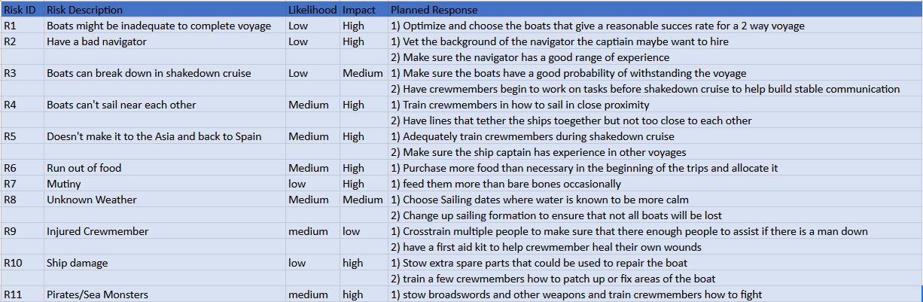
Risk Management Plan

Slide 20
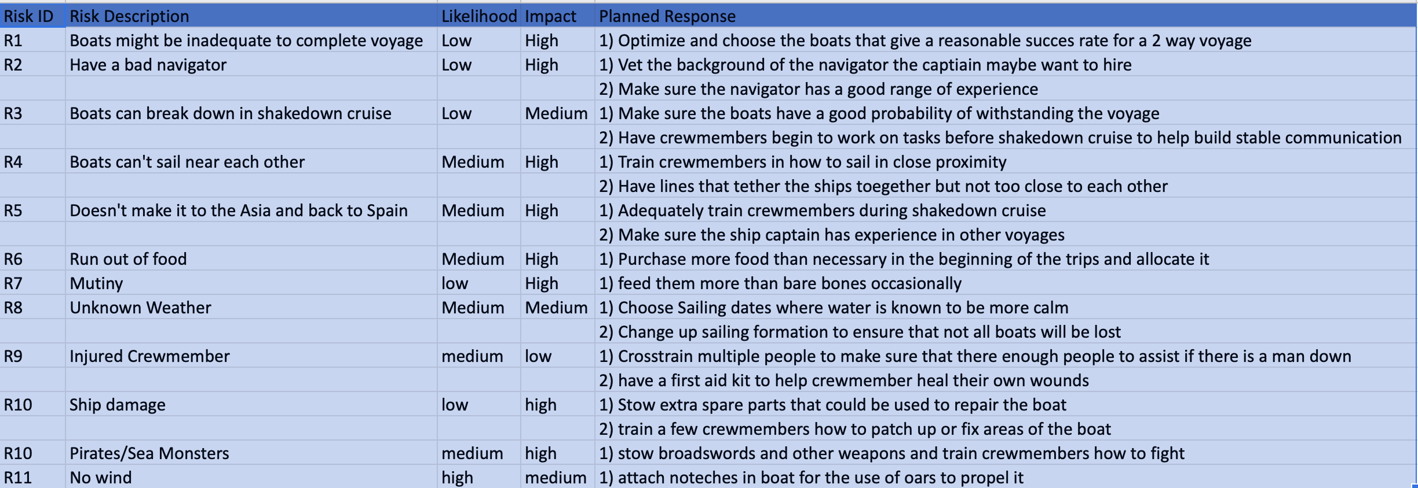
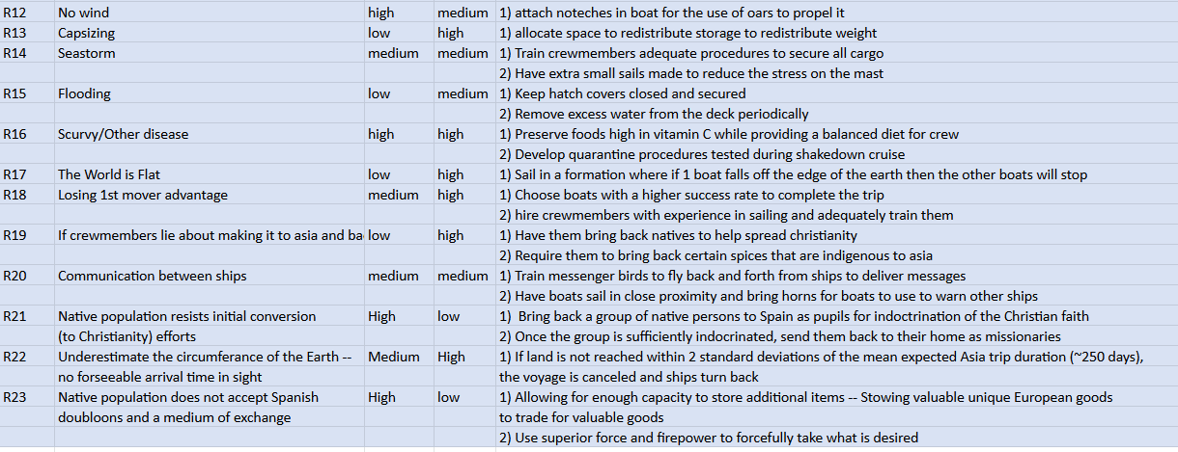
Risk Management Plan Cont.

Slide 21
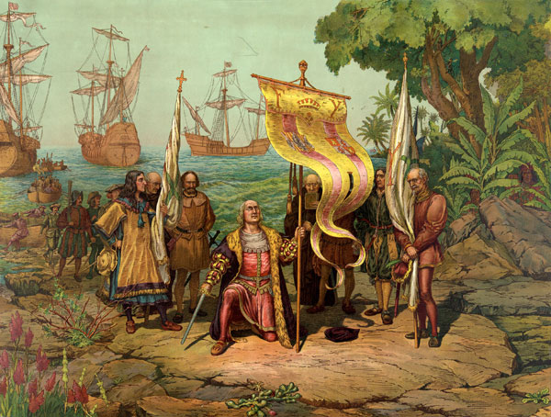
Estimated Project Duration is 275 days at an expected cost of 3.7 million dollars

Slide 22
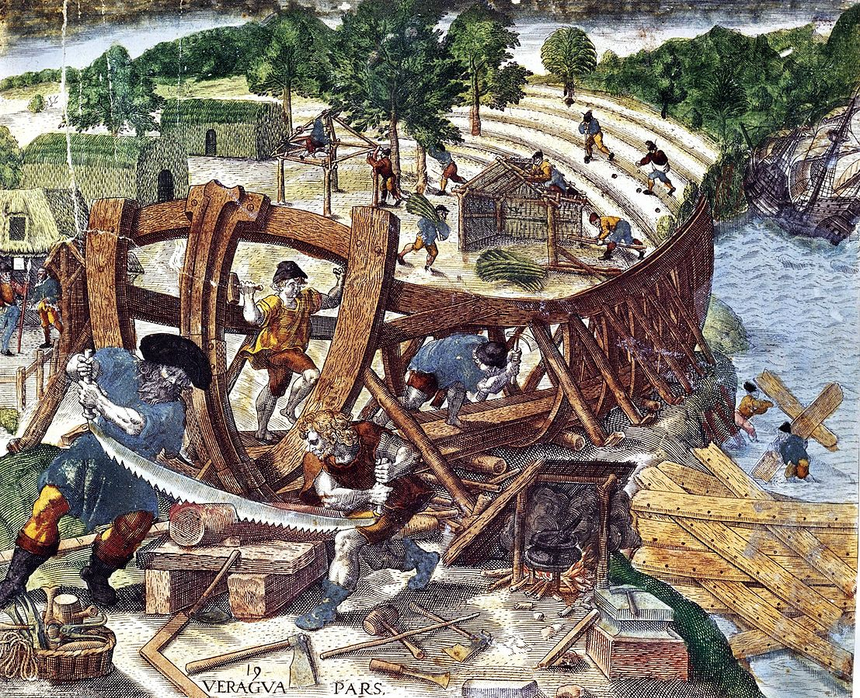
Boat selection Process
Selection based on solver optimization model that minimizes of total costs incurred during the final voyage subject to three constraints:
Constraints
Number of ships purchased | = 3
Average probability of two-way success For selected ships | >= 80%
Minimum total capacity level (sum of selected ships) | 3000

Slide 23
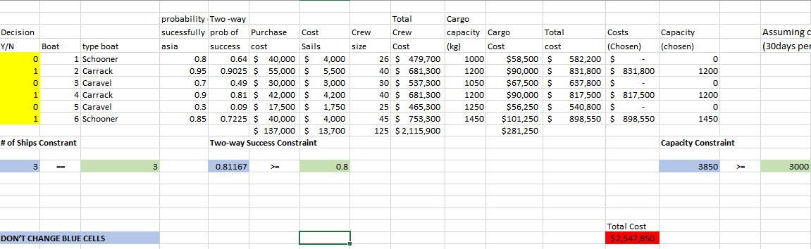
Boat Selection
Minimization of total costs incurred during the final voyage subject to constraints

Slide 24

Key Costs
Selected boats (inclusive of sails and insurance) | $ 191,800
Crew cost | $ 2,410,200
Captain’s salaries | $ 224,148.60
Navigator’s salaries | $ 187,292
Administrative salaries | $ 201,765
Life insurance for captains | $ 102,344.64
Expected cost of shakedown failures | $ 59,211.35
Barebones food expenditure | $ 62,506.25
Hole foods expenditure | $250,025
Boats selected (subject to success probability constraint)
2. Carrack (55k cost)
4. Carrack (42k Cost)
6. Schooner (40k cost)

Slide 25
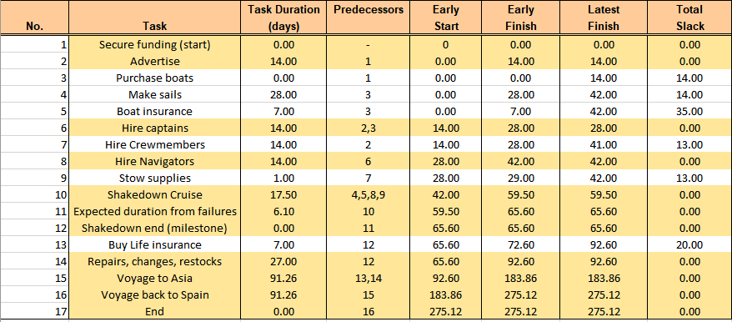
Detailed project Durations table

Slide 26

Expected duration of failed shakedown
Scenario | Probability | Expected duration
Fail first time → succeed on second try | 0.95 * 0.05 = 0.0475 | 5.65 days
Fail both times | 0.05 * 0.05 = 0.0025 | 0.45 days
Added duration from expected failures
6.10 days

Slide 27
Thank you!
Any Questions?

